Slide 1
Linear Maps
Transformation Rules
Notes:
So we’ve finished up our discussion of covectors. In this video we’re going to be talking about our third example of a tensor, which are linear maps. Linear maps are transformations that take a vector as an input and product some new vector as an output.
So in a sense, linear maps move vectors… so you might be wondering, I’ve made this huge deal about how vectors are invariant and how they don’t change.
So I don’t mean that vector don’t change, we can move them around and stuff if we want, what I mean is vectors are invariant, under a coordinate system change. So they are invariant when we change coordinate system, but they can still change in other ways
So just like vectors and covectors, linear maps have a coordinate interpretation that is an array of numbers where the numbers vary depending on the basis. And even though that isn’t the best definition we can offer, it’s a good place to start.

Slide 2


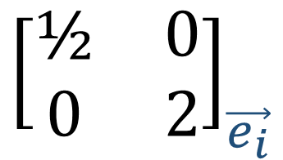
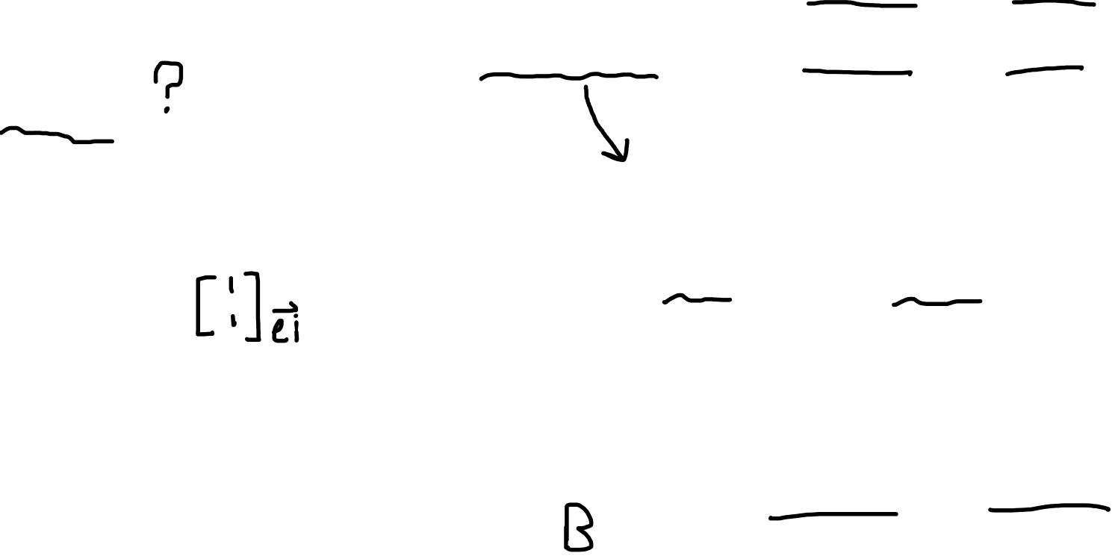


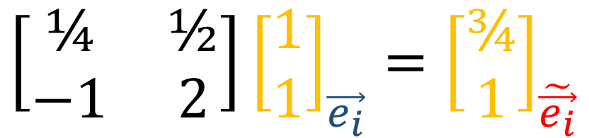

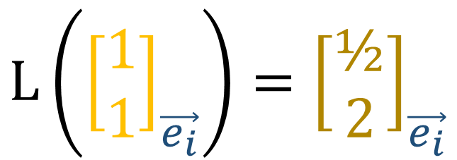
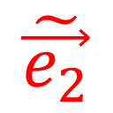
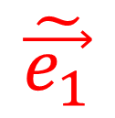
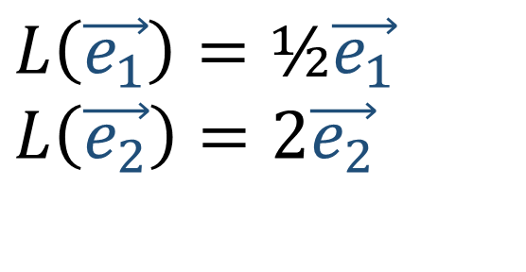
$${\left[\begin{matrix}\text{½} & 0 \\ 0 & 2\end{matrix}\right]}_{\vec{e_{i}}}$$
$$L\left(\vec{e_{1}}\right)=\text{½}\vec{e_{1}}$$
$$L\left(\vec{e_{2}}\right)=2\vec{e_{2}}$$
$$L(\vec{v})$$
$$L\left({\left[\begin{aligned}1 \\ 1\end{aligned}\right]}_{\vec{e_{i}}}\right)={\left[\begin{aligned}\text{½} \\ 2\end{aligned}\right]}_{\vec{e_{i}}}$$
$$\vec{e_{2}}$$
$$\vec{v}$$
$$\tilde{\vec{e_{1}}}$$
$$\left[\begin{matrix}\text{¼} & \text{½} \\ −\text{1} & \text{2}\end{matrix}\right]{\left[\begin{aligned}1 \\ 1\end{aligned}\right]}_{\vec{e_{i}}}={\left[\begin{aligned}¾ \\ 1\end{aligned}\right]}_{\tilde{\vec{e_{i}}}}$$
$$\tilde{\vec{e_{2}}}$$
$$\vec{e_{1}}$$
Notes:
Okay so let’s try and look at all this matrix stuff using a concrete example. So let’s say I have this linear map matrix here, which is expressed in the E-basis. And as a reminder, this is the linear map that turns e1 into 0.5e1, and turns e2 into 2e2.
So let’s say we have this vector V [1,1], and L transforms V into this vector here… what would the components of L-of-V be?
Well, we’d just multiply this vector by this matrix, and we’d get the components one-half, 2.
So all of that is done in the E-basis,
Now remember we can apply the Backward transformation to V’s components in the old basis, to get V’s components in the new basis. Remember we’re using the backward transform since vector components are CONTRA-variant.
So from here, we might ask, what are the components of the output vector in the new basis?
We can use this matrix anymore, since that only works in the old basis…
So what we need to do is figure out how to build output vectors using the e-tilde bases. So we need to figure out these L-tilde coefficients here…

Slide 3
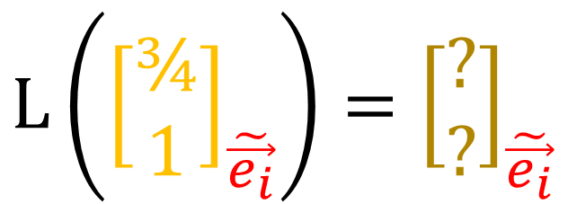
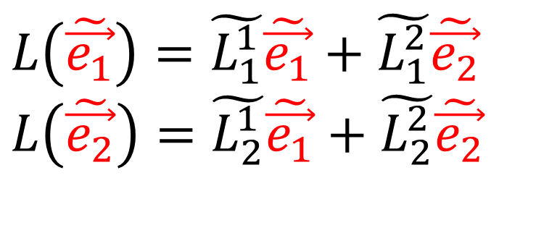

$${\left[\begin{matrix}\text{½} & 0 \\ 0 & 2\end{matrix}\right]}_{\vec{e_{i}}}$$
$$L\left(\vec{e_{1}}\right)=\text{½}\vec{e_{1}}$$
$$L\left(\vec{e_{2}}\right)=2\vec{e_{2}}$$
$$L(\vec{v})$$
$$L\left({\left[\begin{aligned}1 \\ 1\end{aligned}\right]}_{\vec{e_{i}}}\right)={\left[\begin{aligned}\text{½} \\ 2\end{aligned}\right]}_{\vec{e_{i}}}$$
$$\vec{e_{2}}$$
$$\vec{v}$$
$$\tilde{\vec{e_{1}}}$$
$$L\left({\left[\begin{aligned}¾ \\ 1\end{aligned}\right]}_{\tilde{\vec{e_{i}}}}\right)={\left[\begin{aligned}\text{?} \\ ?\end{aligned}\right]}_{\tilde{\vec{e_{i}}}}$$
$$\tilde{\vec{e_{2}}}$$
$$\vec{e_{1}}$$
$$L\left(\tilde{\vec{e_{1}}}\right)=\tilde{L_{1}^{1}}\tilde{\vec{e_{1}}}+\tilde{L_{1}^{2}}\tilde{\vec{e_{2}}}$$
$$L\left(\tilde{\vec{e_{2}}}\right)=\tilde{L_{2}^{1}}\tilde{\vec{e_{1}}}+\tilde{L_{2}^{2}}\tilde{\vec{e_{2}}}$$
Notes:
Okay so let’s try and look at all this matrix stuff using a concrete example. So let’s say I have this linear map matrix here, which is expressed in the E-basis. And as a reminder, this is the linear map that turns e1 into 0.5e1, and turns e2 into 2e2.
So let’s say we have this vector V [1,1], and L transforms V into this vector here… what would the components of L-of-V be?
Well, we’d just multiply this vector by this matrix, and we’d get the components one-half, 2.
So all of that is done in the E-basis,
Now remember we can apply the Backward transformation to V’s components in the old basis, to get V’s components in the new basis. Remember we’re using the backward transform since vector components are CONTRA-variant.
So from here, we might ask, what are the components of the output vector in the new basis?
We can use this matrix anymore, since that only works in the old basis…
So what we need to do is figure out how to build output vectors using the e-tilde bases. So we need to figure out these L-tilde coefficients here…

Slide 4



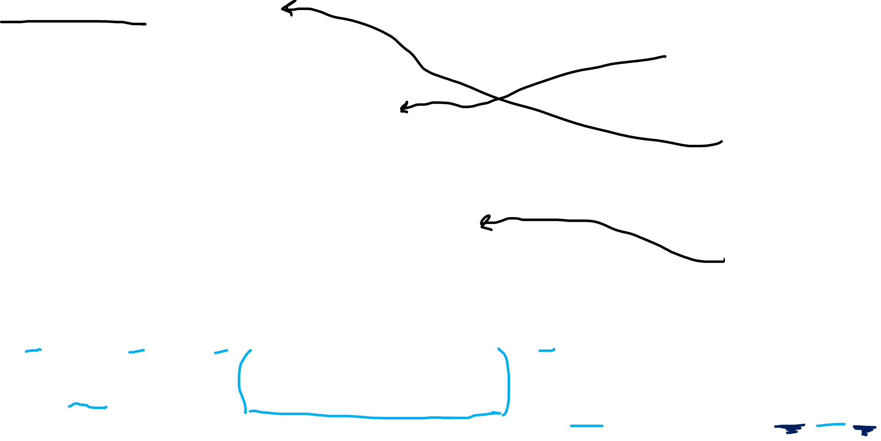
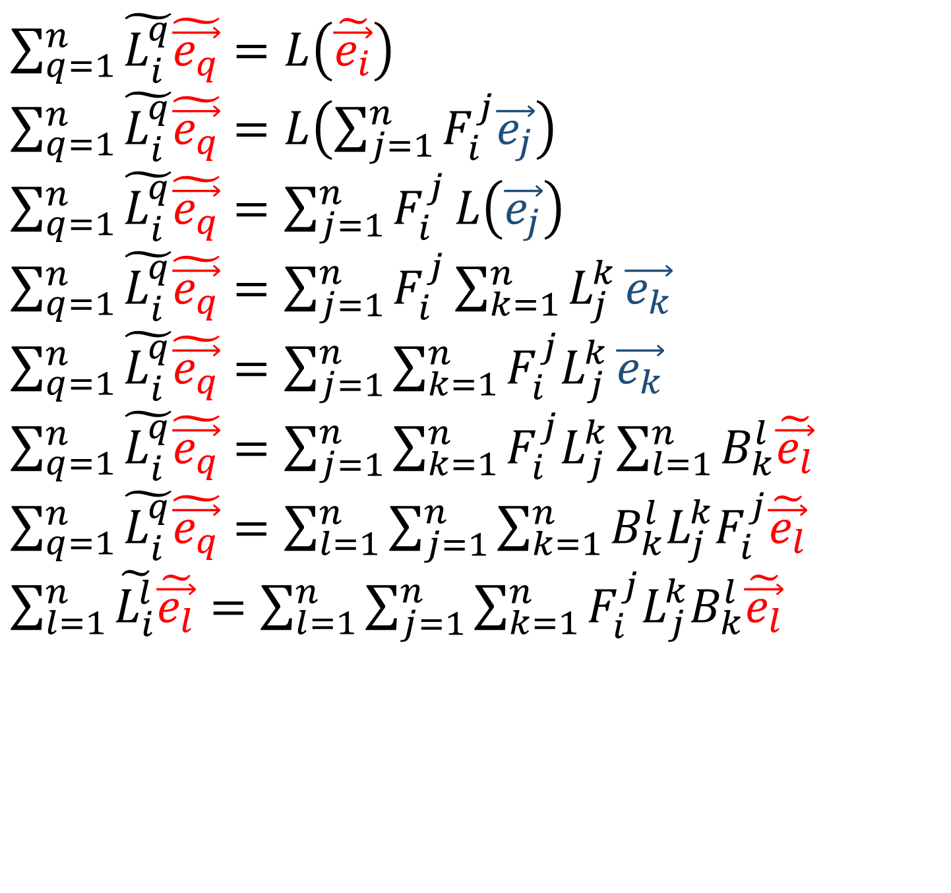


$\sum_{q=1}^{n}{\tilde{L_{i}^{q}}\tilde{\vec{e_{q}}}}=L\left(\tilde{\vec{e_{i}}}\right)$
$\sum_{q=1}^{n}{\tilde{L_{i}^{q}}\tilde{\vec{e_{q}}}}=L\left(\sum_{j=1}^{n}{F_{i}^{j}\vec{e_{j}}}\right)$
$\sum_{q=1}^{n}{\tilde{L_{i}^{q}}\tilde{\vec{e_{q}}}}=\sum_{j=1}^{n}{F_{i}^{j}}L\left(\vec{e_{j}}\right)$
$\sum_{q=1}^{n}{\tilde{L_{i}^{q}}\tilde{\vec{e_{q}}}}=\sum_{j=1}^{n}{F_{i}^{j}}\sum_{k=1}^{n}{L_{j}^{k}}\vec{e_{k}}$
$\sum_{q=1}^{n}{\tilde{L_{i}^{q}}\tilde{\vec{e_{q}}}}=\sum_{j=1}^{n}{\sum_{k=1}^{n}{{F_{i}^{j}L}_{j}^{k}}\vec{e_{k}}}$
$\sum_{q=1}^{n}{\tilde{L_{i}^{q}}\tilde{\vec{e_{q}}}}=\sum_{j=1}^{n}{\sum_{k=1}^{n}{{F_{i}^{j}L}_{j}^{k}}\sum_{l=1}^{n}{B_{k}^{l}\tilde{\vec{e_{l}}}}}$
$\sum_{q=1}^{n}{\tilde{L_{i}^{q}}\tilde{\vec{e_{q}}}}=\sum_{l=1}^{n}{\sum_{j=1}^{n}{\sum_{k=1}^{n}{B_{k}^{l}L_{j}^{k}F_{i}^{j}\tilde{\vec{e_{l}}}}}}$
$\sum_{l=1}^{n}{\tilde{L_{i}^{l}}\tilde{\vec{e_{l}}}}=\sum_{l=1}^{n}{\sum_{j=1}^{n}{\sum_{k=1}^{n}{{{F_{i}^{j}L}_{j}^{k}B}_{k}^{l}\tilde{\vec{e_{l}}}}}}$
$$L\left(\vec{e_{j}}\right)=\sum_{k=1}^{n}{L_{j}^{k}}\vec{e_{k}}$$
$$\tilde{\vec{e_{i}}}=\sum_{j=1}^{n}{F_{i}^{j}\vec{e_{j}}}$$
$$\vec{e_{k}}=\sum_{l=1}^{n}{B_{k}^{l}\tilde{\vec{e_{l}}}}$$
$$\tilde{L_{i}^{l}}=\sum_{j=1}^{n}{\sum_{k=1}^{n}{B_{k}^{l}L_{j}^{k}F_{i}^{j}}}$$
Notes:
So first, we use our Forward transformation to re-write the e-tildes in terms of the old basis.
Now we apply the linearity of L to take the sum and scaling coefficients outside.
Now we use this definition here to write the output f L-of-e-JAY as a linear combination of the old.
Now we rearrange the sums a bit….
Now we rewrite the old basis in terms of the e-tildes using the backward transform
And we rearrange the sums one more time.
So on the left, we have a linear combination of e-tilde vectors, using the summation index Q.
And on the right we have a linear combination of e-tilde vectors again, using the summation index L.
So we have a linear combination on both sides… but with different summation indexes….
But really our choice of letter to do the sum doesn’t really matter, right? We could choose any letter we want. So I’m going to just change these Qs to Ls…
And now we can see that these L-tilde coefficients are equal to all this here…
So really what this is saying is that to transform matrix coordinates from the old basis to the new basis, we multiply the old matrix by the Backward transform on the left, and the forward transform on the right…

Slide 5

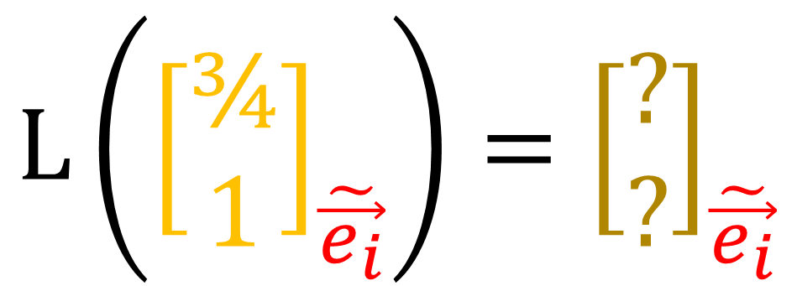
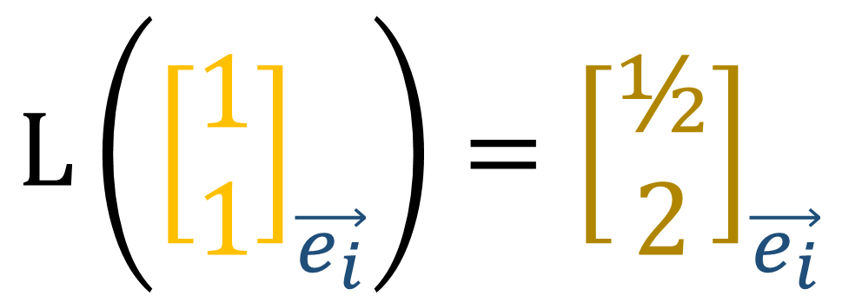
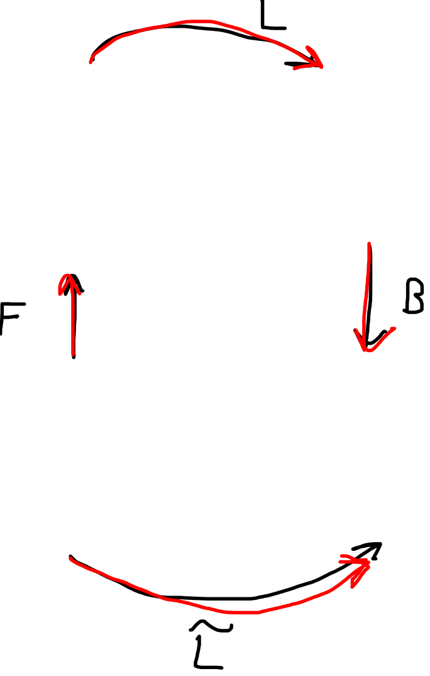
$$L\left({\left[\begin{aligned}1 \\ 1\end{aligned}\right]}_{\vec{e_{i}}}\right)={\left[\begin{aligned}\text{½} \\ 2\end{aligned}\right]}_{\vec{e_{i}}}$$
$$\tilde{L_{i}^{l}}=\sum_{j=1}^{n}{\sum_{k=1}^{n}{B_{k}^{l}L_{j}^{k}F_{i}^{j}}}$$
$$L\left({\left[\begin{aligned}¾ \\ 1\end{aligned}\right]}_{\tilde{\vec{e_{i}}}}\right)={\left[\begin{aligned}\text{?} \\ ?\end{aligned}\right]}_{\tilde{\vec{e_{i}}}}$$
Notes:
So matrices, or linear maps, transform with both the forward transform AND the backward transform. And I’ll show you why that makes sense.
So the L tilde matrix, takes us from the input vector to the output vector in the new basis, right? So instead of going direction from here to here…. We’re going to go a sort of round-about way, like this.
So to travel along this arrow, to transform new vector components into old vector components, we use the forward transform.
And here to transform components of the input vector into components of the output vector, we use the matrix L
And finally, to get from old vector components to new vector components, we use the backward transform.
So moving along this arrow, multiplication by the L-tilde matrix, is really the same thing as moving along these three arrows, so forward, then L, then backward.
So the idea of transforming matrix components using both the forward and backward transformations makes sense.
Now let’s see that work in practice.

Slide 6
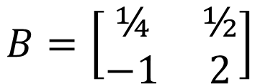


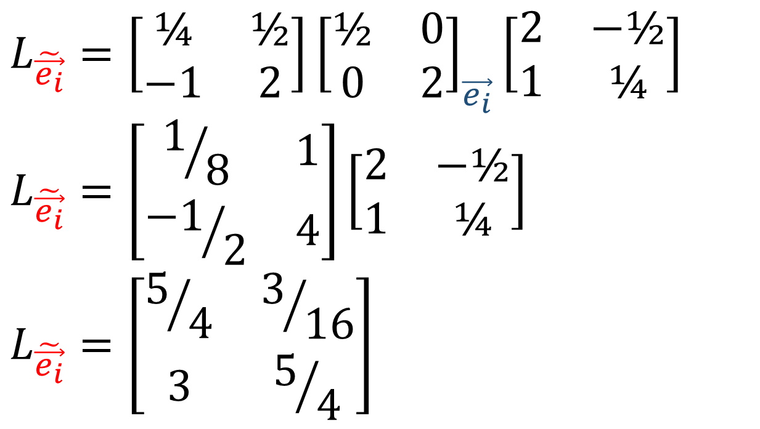

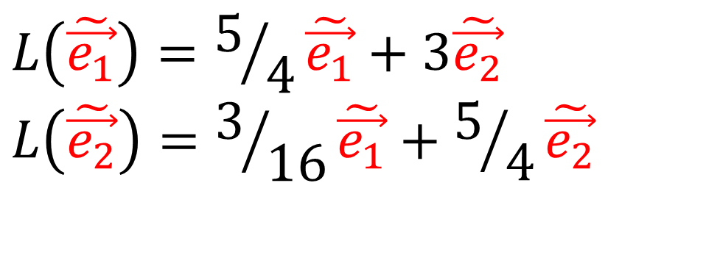
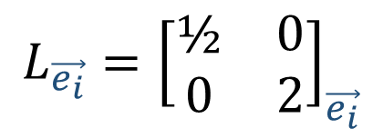
$$L_{\tilde{\vec{e_{i}}}}=\left[\begin{matrix}\text{¼} & \text{½} \\ −\text{1} & \text{2}\end{matrix}\right]{\left[\begin{matrix}\text{½} & 0 \\ 0 & 2\end{matrix}\right]}_{\vec{e_{i}}}\left[\begin{matrix}2 & −\text{½} \\ 1 & \text{¼}\end{matrix}\right]$$
$$L_{\tilde{\vec{e_{i}}}}=\left[\begin{matrix}1/8 & 1 \\ {−1}/2 & \text{4}\end{matrix}\right]\left[\begin{matrix}2 & −\text{½} \\ 1 & \text{¼}\end{matrix}\right]$$
$$L_{\tilde{\vec{e_{i}}}}=\left[\begin{matrix}5/4 & 3/{16} \\ 3 & 5/4\end{matrix}\right]$$
$$\tilde{L_{i}^{l}}=\sum_{j=1}^{n}{\sum_{k=1}^{n}{B_{k}^{l}L_{j}^{k}F_{i}^{j}}}$$
$$F=\left[\begin{matrix}2 & −\text{½} \\ 1 & \text{¼}\end{matrix}\right]$$
$$B=\left[\begin{matrix}\text{¼} & \text{½} \\ −\text{1} & \text{2}\end{matrix}\right]$$
$${L_{\vec{e_{i}}}=\left[\begin{matrix}\text{½} & 0 \\ 0 & 2\end{matrix}\right]}_{\vec{e_{i}}}$$
$$L\left(\tilde{\vec{e_{1}}}\right)=5/4\tilde{\vec{e_{1}}}+3\tilde{\vec{e_{2}}}$$
$$L\left(\tilde{\vec{e_{2}}}\right)=3/{16}\tilde{\vec{e_{1}}}+5/4\tilde{\vec{e_{2}}}$$
Notes:
So here to get our matrix in the new basis, we start with the matrix in the old basis, and multiply on the left by B and on the right by F.
So if we churn through all this… we get this matrix here…
And that tells us how to write the outputs of the linear map as linear combinations of the new basis.

Slide 7
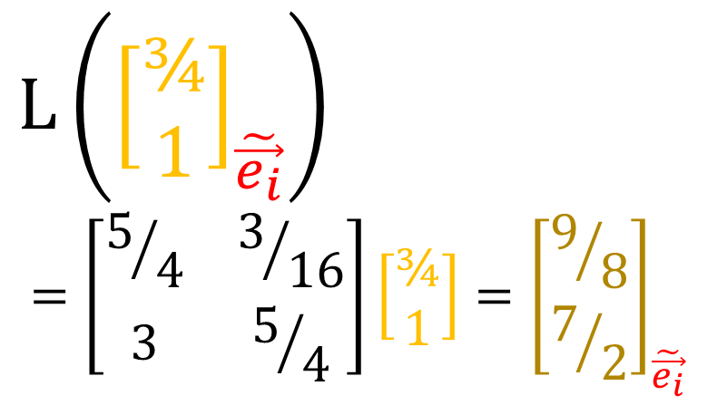
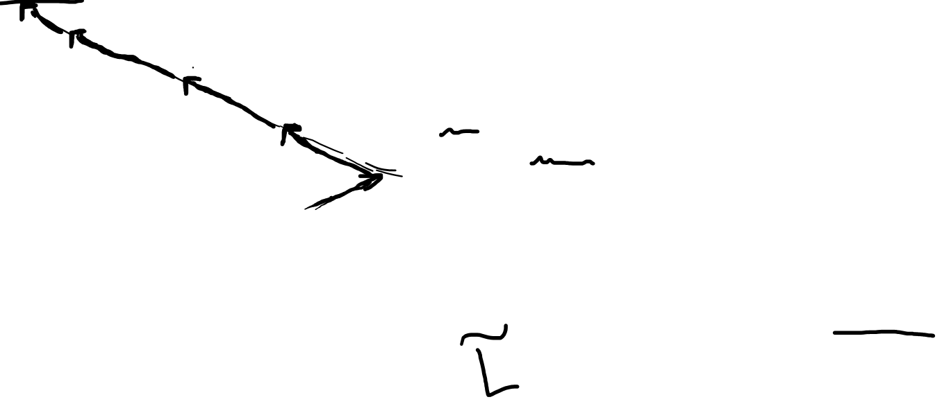
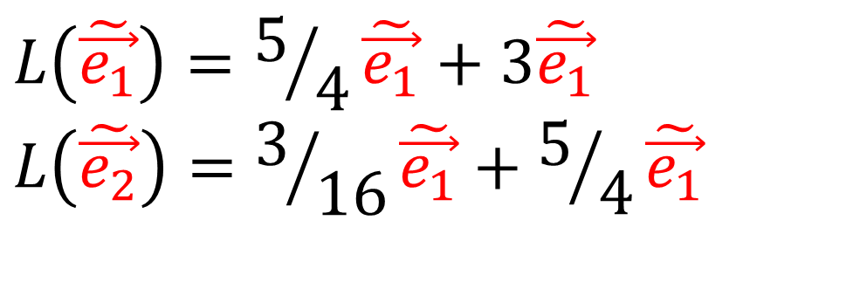
$$L\left(\tilde{\vec{e_{1}}}\right)=5/4\tilde{\vec{e_{1}}}+3\tilde{\vec{e_{1}}}$$
$$L\left(\tilde{\vec{e_{2}}}\right)=3/{16}\tilde{\vec{e_{1}}}+5/4\tilde{\vec{e_{1}}}$$
$$L(\vec{v})$$
$L\left({\left[\begin{aligned}¾ \\ 1\end{aligned}\right]}_{\tilde{\vec{e_{i}}}}\right)$
$$=\left[\begin{matrix}5/4 & 3/{16} \\ 3 & 5/4\end{matrix}\right]\left[\begin{aligned}¾ \\ 1\end{aligned}\right]={\left[\begin{aligned}9/8 \\ 7/2\end{aligned}\right]}_{\tilde{\vec{e_{i}}}}$$
$$\vec{e_{2}}$$
$$\vec{v}$$
$$\tilde{\vec{e_{1}}}$$
$$\tilde{\vec{e_{2}}}$$
$$\vec{e_{1}}$$
Notes:
So let’s see if that worked.
We want to transform these new-basis vector components, so let’s apply the new matrix we just got, and we get the components 9/8th and 7/2….
So let’s just check if that makes sense… let’s measure L(v) using the new basis…
So that looks like slightly more than 1 e1-tilde, so about 9/8th.
And about 3-and-a-half e2-tildes, and three-and-a-half is just another way of saying 7/2. So this new matrix does what we want.

Slide 8
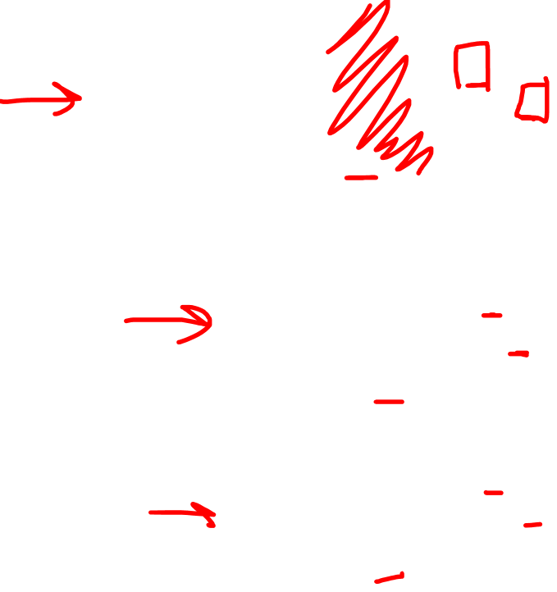
$\sum_{q=1}^{n}{\tilde{L_{i}^{q}}\tilde{\vec{e_{q}}}}=L\left(\tilde{\vec{e_{i}}}\right)$
$\sum_{q=1}^{n}{\tilde{L_{i}^{q}}\tilde{\vec{e_{q}}}}=L\left(\sum_{j=1}^{n}{F_{i}^{j}\vec{e_{j}}}\right)$
$\sum_{q=1}^{n}{\tilde{L_{i}^{q}}\tilde{\vec{e_{q}}}}=\sum_{j=1}^{n}{F_{i}^{j}}L\left(\vec{e_{j}}\right)$
$\sum_{q=1}^{n}{\tilde{L_{i}^{q}}\tilde{\vec{e_{q}}}}=\sum_{j=1}^{n}{F_{i}^{j}}\sum_{k=1}^{n}{L_{j}^{k}}\vec{e_{k}}$
$\sum_{q=1}^{n}{\tilde{L_{i}^{q}}\tilde{\vec{e_{q}}}}=\sum_{j=1}^{n}{\sum_{k=1}^{n}{{F_{i}^{j}L}_{j}^{k}}\vec{e_{k}}}$
$\sum_{q=1}^{n}{\tilde{L_{i}^{q}}\tilde{\vec{e_{q}}}}=\sum_{j=1}^{n}{\sum_{k=1}^{n}{{F_{i}^{j}L}_{j}^{k}}\sum_{l=1}^{n}{B_{k}^{l}\tilde{\vec{e_{l}}}}}$
$\sum_{q=1}^{n}{\tilde{L_{i}^{q}}\tilde{\vec{e_{q}}}}=\sum_{l=1}^{n}{\sum_{j=1}^{n}{\sum_{k=1}^{n}{B_{k}^{l}L_{j}^{k}F_{i}^{j}\tilde{\vec{e_{l}}}}}}$
$\sum_{l=1}^{n}{\tilde{L_{i}^{l}}\tilde{\vec{e_{l}}}}=\sum_{l=1}^{n}{\sum_{j=1}^{n}{\sum_{k=1}^{n}{{{F_{i}^{j}L}_{j}^{k}B}_{k}^{l}\tilde{\vec{e_{l}}}}}}$
$$L\left(\vec{e_{j}}\right)=\sum_{k=1}^{n}{L_{j}^{k}}\vec{e_{k}}$$
$$\tilde{\vec{e_{i}}}=\sum_{j=1}^{n}{F_{i}^{j}\vec{e_{j}}}$$
$$\vec{e_{k}}=\sum_{l=1}^{n}{B_{k}^{l}\tilde{\vec{e_{l}}}}$$
$$\tilde{L_{i}^{l}}=\sum_{j=1}^{n}{\sum_{k=1}^{n}{B_{k}^{l}L_{j}^{k}F_{i}^{j}}}$$
Notes:
Now one thing I want to do before ending the video is to make you life easier.
So just remember this derivation that we did here to transform matrix components… it’s pretty pretty ugly right? There’s a ton to write out, we have to write out a ton of summation signs…
Fortunately, there’s a way to make all this much, much easier.
And the key to that is noticing something interesting about the summations….
Notice that up here this summation is over K, and we have K up top and a K down low here…
And this summation is over JAY, and again we have a JAY up top and a JAY down low
And something here… sum of L, L up top, L down low.
So it turns out… any time we have an index letter on top and on the bottom, we end up summing over that index letter.
So really, we don’t really need to write these summation signs at all… we can kind of just pretend that they’re there… because when we see an index repeated on the top and bottom… we know that there’s a summation.

Slide 9


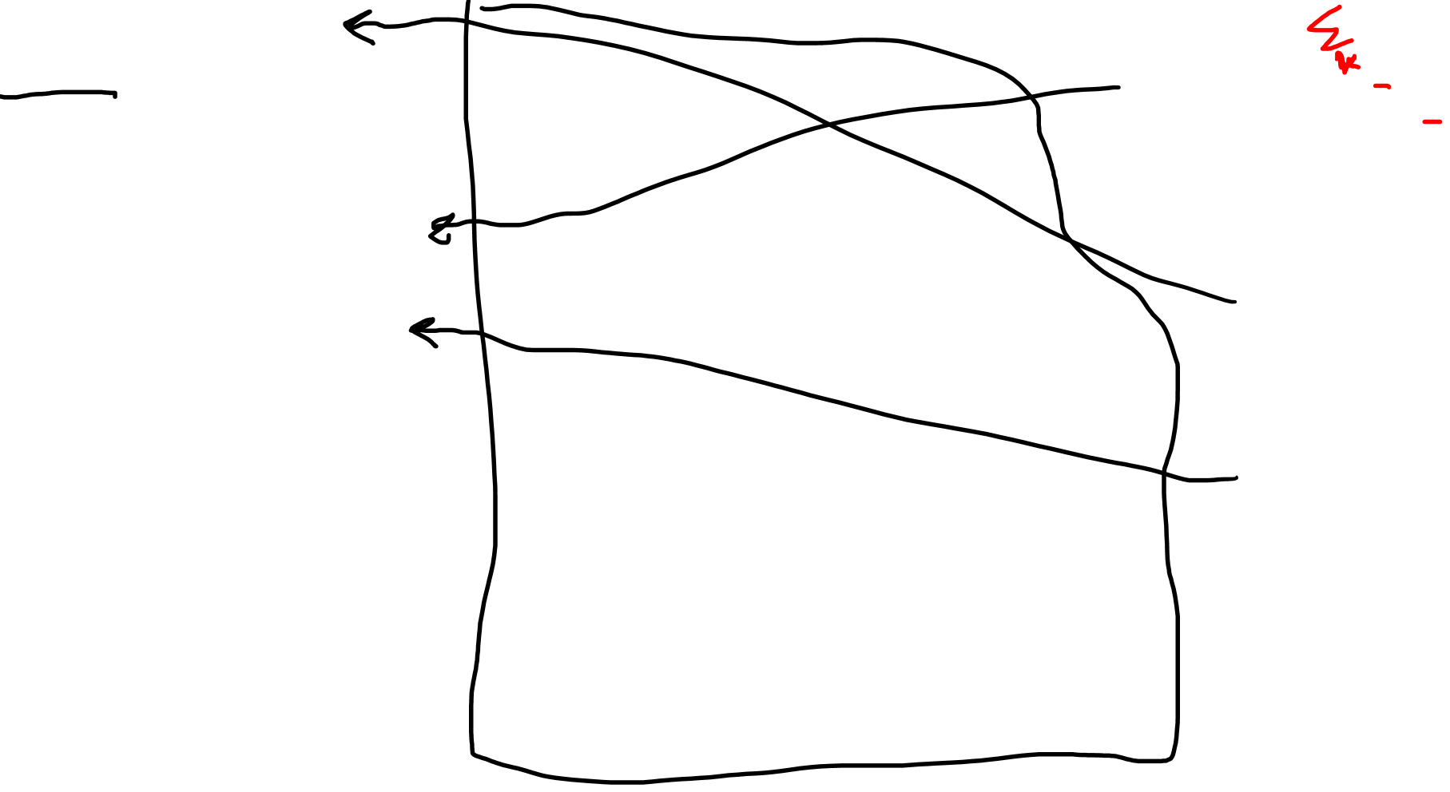

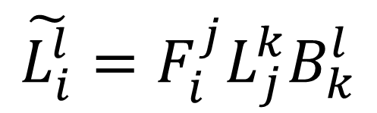

$\tilde{L_{i}^{q}}\tilde{\vec{e_{q}}}=L\left(\tilde{\vec{e_{i}}}\right)$
$\tilde{L_{i}^{q}}\tilde{\vec{e_{q}}}=L\left(F_{i}^{j}\vec{e_{j}}\right)$
$\tilde{L_{i}^{q}}\tilde{\vec{e_{q}}}=F_{i}^{j}L\left(\vec{e_{j}}\right)$
$\tilde{L_{i}^{q}}\tilde{\vec{e_{q}}}=F_{i}^{j}L_{j}^{k}\vec{e_{k}}$
$$\tilde{L_{i}^{q}}\tilde{\vec{e_{q}}}={F_{i}^{j}L}_{j}^{k}B_{k}^{l}\tilde{\vec{e_{l}}}$$
$$\tilde{L_{i}^{l}}\tilde{\vec{e_{l}}}={{F_{i}^{j}L}_{j}^{k}B}_{k}^{l}\tilde{\vec{e_{l}}}$$
$$L\left(\vec{e_{j}}\right)=L_{j}^{k}\vec{e_{k}}$$
$$\tilde{\vec{e_{i}}}=F_{i}^{j}\vec{e_{j}}$$
$$\vec{e_{k}}=B_{k}^{l}\tilde{\vec{e_{l}}}$$
$$\tilde{L_{i}^{l}}={{F_{i}^{j}L}_{j}^{k}B}_{k}^{l}$$
Notes:
Now let me prove to you, how much easier that makes our lives.
Let’s try this derivation again, but not writing in the summation signs, we just know that if an index appears on top and on the bottom, that a summation is going on…
So we start by writing L-of-E-tilde as a linear combination of the e-tilde basis.
We invoke the forward transform here
We use the linearity of L
We use the definition of the L coefficients
We invoke the backward transformation
We change this summation index from Q to L
And that’s it! We’re done!
Look at how much space we saved… look at all this blank space… it’s so easy…

Slide 10
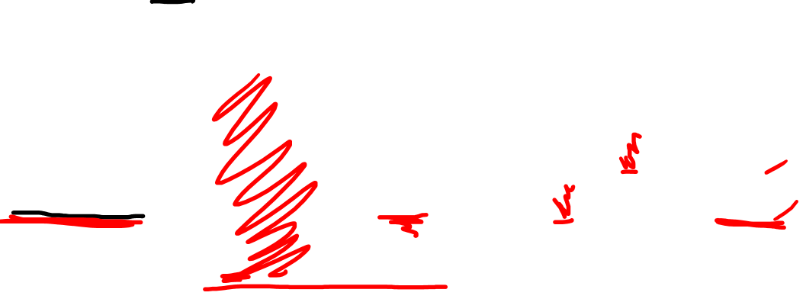

Multiplying by the identity matrix…
$$MI=M$$
$${\left(MI\right)}_{k}^{i}=\sum_{j=1}^{n}{M_{j}^{i}δ_{k}^{j}=M_{j}^{i}δ_{k}^{j}=M_{k}^{i}}$$
Notes:
Now here’s another trick to make our lives easier…
Let’s consider what happens when we multiply a matrix M, by the identity matrix… we should just get the matrix M back, right?
Well, let’s consider the components of this matrix… let’s look at the component i,k…
This is just the multiplication of the M and I matrices, right?
So we can write that as a multiplication of the M components with the Kronecker delta… because remember the Kronecker delta gives us the components of the identity matrix…
Now again… we can just forget the summation sign is there because we see JAY on top and JAY on the bottom…
But all of this, should just be equal to M-EYE-KAY, right? Because the identity matrix shouldn’t change the components of M…. MI and M have the same components….
So really what the Kronecker delta is doing… is it sort of cancels out summation indexes… right?
It’s almost as if this summation index JAY is just being cancelled out, and we’re left with EYE on top and K on the bottom.
So the kroncker delta is a bit like an summation index canceller…

Slide 11
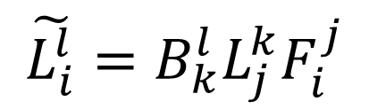
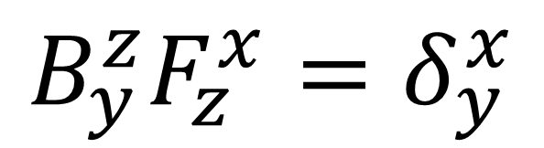
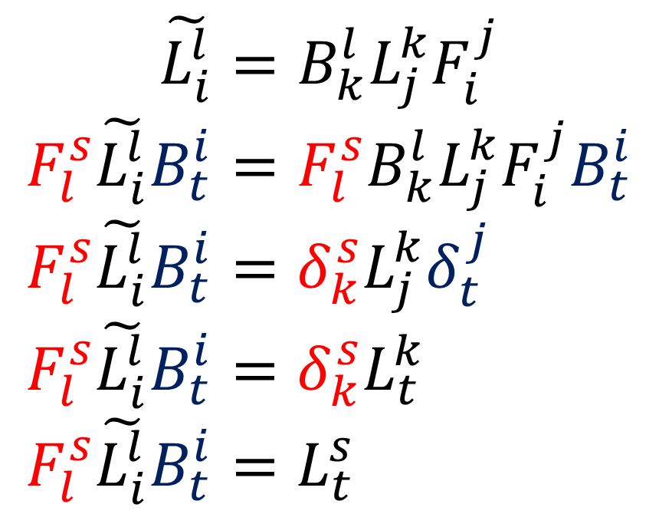
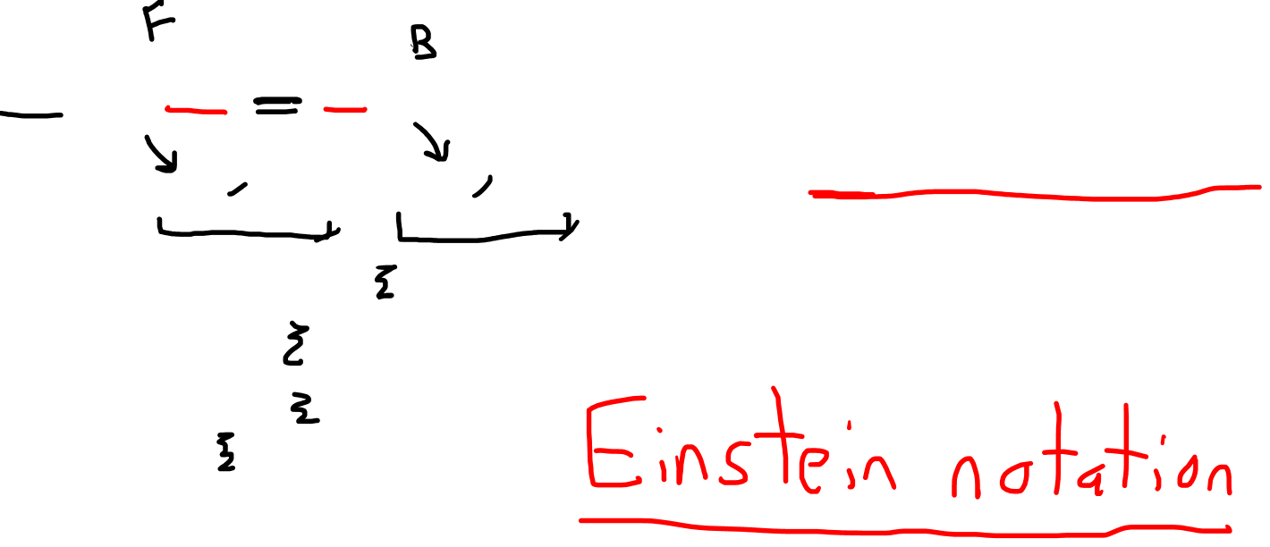
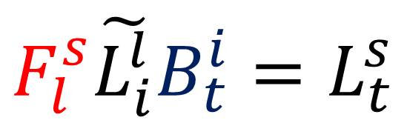
$$\tilde{L_{i}^{l}}=B_{k}^{l}L_{j}^{k}F_{i}^{j}$$
$$F_{l}^{s}\tilde{L_{i}^{l}}B_{t}^{i}=F_{l}^{s}B_{k}^{l}L_{j}^{k}F_{i}^{j}B_{t}^{i}$$
$F_{l}^{s}\tilde{L_{i}^{l}}B_{t}^{i}=δ_{k}^{s}L_{j}^{k}δ_{t}^{j}$
$F_{l}^{s}\tilde{L_{i}^{l}}B_{t}^{i}=δ_{k}^{s}L_{t}^{k}$
$F_{l}^{s}\tilde{L_{i}^{l}}B_{t}^{i}=L_{t}^{s}$
$${B_{y}^{z}F}_{z}^{x}=δ_{y}^{x}$$
$$F_{l}^{s}\tilde{L_{i}^{l}}B_{t}^{i}=L_{t}^{s}$$
$$\tilde{L_{i}^{l}}=B_{k}^{l}L_{j}^{k}F_{i}^{j}$$
Notes:
So let’s use all these tricks that we’ve learned and derive the backward transformation for matrix components.
So we have the forward transform here, where we move from the old components L to the new components L-tilde… and we just have a reminder here that the forward and backward matrices multiply to give us the identity…
So we want to get the normal L coefficients isolated on one side, right?
Well to do that, we need to get rid of the B and F…
And we can do that by multiplying the left sight by F, and the right side by B… because the Fs and Bs should cancel out, right?
So let’s do that now… we multiply boths sides by F on the left and B on the right…
Now… these would cancel to give us the kroncker delta ESS-KAY…. And these would cancel to give use the Kronecker delta JAY-TEE
Okay so we’re left with a couple Kronecker deltas on the right side…
And remember the Kronecker deltas are like summation index cancellers…
So here, this Kronecker delta cancels out the J-index, so we’re left with TEE on the bottom…
And this Kronecker delta cancels out the K-index, so we’re left with ESS on top..
And we’re done, in just 5 lines, we managed to convert the forward transformation for matrices into the backward transformation…
So this way of leaving out the summation signs is super-super useful… and we call this way of writing tensor components… Einstein’s notation…. So we’re going to be writing tensors like this from now on because of how easy it makes our lives.

Slide 12




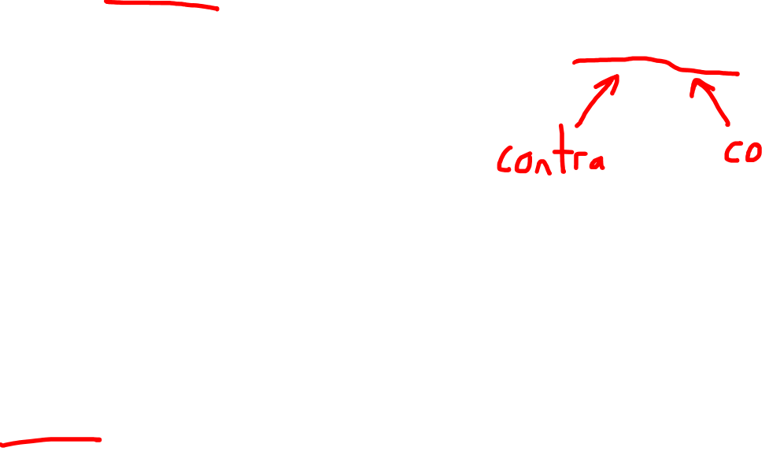






Contravariant (1,0)-Tensor
(1,1)-Tensor
$$\tilde{ε^{i}} =B_{j}^{i}ε^{j}$$
$$\tilde{v^{i}}=B_{j}^{i}v^{j}$$
$$ε^{i}=F_{j}^{i}\tilde{ε^{j}}$$
$$v^{i}=F_{j}^{i}\tilde{v^{j}}$$
$$\tilde{L_{j}^{i}}=B_{k}^{i}L_{l}^{k}F_{j}^{l}$$
Covariant (0,1)-Tensor
$$L_{j}^{i}=F_{k}^{i}\tilde{L_{l}^{k}}B_{j}^{l}$$
$$\tilde{\vec{e_{j}}}=F_{j}^{i}\vec{e_{i}}$$
$$\tilde{α_{j}}=F_{j}^{i}α_{i}$$
$$\vec{e_{j}}=B_{j}^{i}\tilde{\vec{e_{i}}}$$
$$α_{j}=B_{j}^{i}\tilde{α_{i}}$$
Notes:
Okay so to sum up everything we’ve learned so far…
We learned that basis COvectors, and vector components, transformed using the CONTRA-variant law
And from now on we’re going to be calling these 1-0 tensors
We learned that basis vectors and COvector components transformed using the CO-variant law
And from now on we’re going to be calling these 0-1 tensors
And now, we’ve learned that linear maps transform using both the forward and the backward matrices, so in a sense they are both contravariant AND covariant… and because of that, we’re going to call them 1-1 tensors…
So that finishes up linear maps…
Next will be our final example of a tensor, which is the metric tensor…

